Slide 1

Evaluating a transformer-based language model for in-domain and cross-domain offensive language detection on perturbated data
Michiel van Nederpelt

Slide 2
“The best way to fight hate speech is with better speech” – Marilyn Mayo

Slide 4

"100 lashes if you don't die laughing!"

Slide 6
Offensive or not?
“@politico No. We should remember very clearly that #Individual1 just admitted to treason. #TrumpIsATraitor #McCainsAHero #JohnMcCainDay”

Slide 7

Offensive or not?
“@politico No. We should remember very clearly that #Individual1 just admitted to treason. #TrumpIsATraitor #McCainsAHero #JohnMcCainDay”

Slide 8
Offensive or not?
“DON'T support a country Who has Concentration Camps againts small etnich groups and religions DON'T support the violencie and discrimination 🚫 #HumanRights #BoycottChina #StopRacismo #Diversity #China #EndHate #StopViolence ”

Slide 9
Offensive or not?
“DON'T support a country Who has Concentration Camps againts small etnich groups and religions DON'T support the violencie and discrimination 🚫 #HumanRights #BoycottChina #StopRacismo #Diversity #China #EndHate #StopViolence ”
NOT

Slide 10
Offensive or not?
“@TheRealOJ32 Of all the retired NFL players, why is it that you DON’T suffer from CTE? You should be at the bottom of a pool you mistook for an elevator. #murderer”

Slide 11
Offensive or not?
“@TheRealOJ32 Of all the retired NFL players, why is it that you DON’T suffer from CTE? You should be at the bottom of a pool you mistook for an elevator. #murderer”

Slide 12
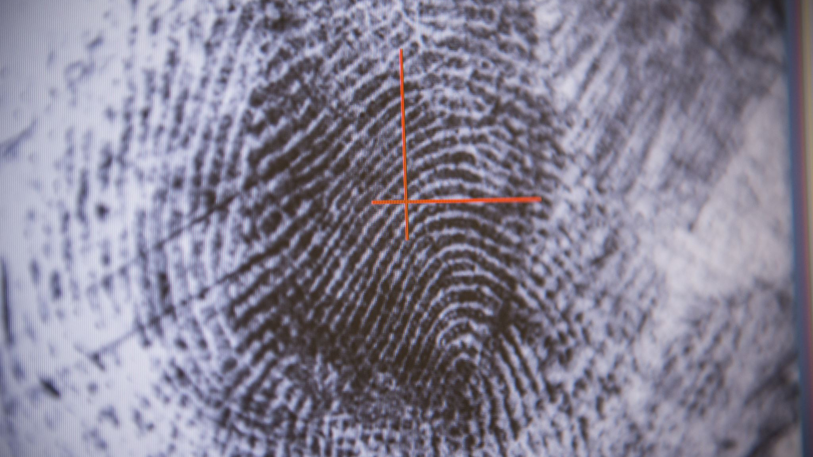
The task of offensive language detection

Slide 13
€valuating a transf0rmer-based language model for !n-domain and cro$s-domain off€nsive language detect!on on p€rturbated data 🤬 🤬 🤬 🤬

Slide 14
Overview of project
Phase 1:
Phase 2:
Phase 3:
Phase 4:
Preprocess datasets
Preprocess datasets
Preprocess datasets
Preprocess datasets
Train OLID
Train HASOC
Train OLID
Train HASOC
Train OLID
Train HASOC
Train HASOC & OLID
Test OLID
Test HASOC
Test HASOC
Test OLID
Perturbate Test OLID
Perturbate
Test HASOC
Perturbate Test OLID
Perturbate
Test HASOC
evaluate
evaluate
evaluate
evaluate

Slide 15
Previous research
Aggression identification
Cyber bullying
Hate speech
Toxic comments
Offensive language

Slide 16
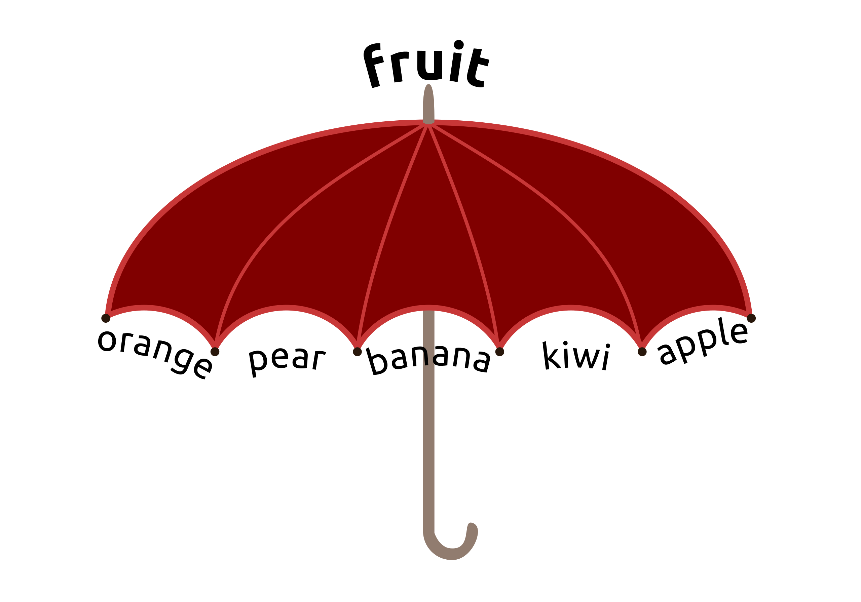
Umbrellla term
Abusive language
Aggression
Hate speech
Toxic comments
Cyber bullying
Offensive language

Slide 17
Hate speech vs. Offensive language
My apologies for the profanity

Slide 18
Hate speech vs. Offensive language
Stupid f*cking n*gger LeBron. You flipping jun-gle bunny monkey f*ggot
Hate Speech
Why you worried bout that other h*e? Cuz that other h*e aint worried bout another h*e
Offensive

Slide 19
Umbrella term
Abusive language
whether the abuse is directed at a specific
target or towards a generalized group.
2. the degree to which the abuse is explicit or implicit.
Aggression
Hate speech
Toxic comments
Cyber bullying
Offensive language

Slide 20

Data
The Hate Speech and Offensive Content-Dataset (HASOC)
The Offensive Language Identification Dataset (OLID)
Difference datasets and commonalities
Basic statistics
Dataset | Instances | Not offensive | Offensive
OLID train | 13240 | 8840 | 4400
OLID test | 859 | 620 | 239
HASOC train | 4681 | 2872 | 1809
HASOC test | 1171 | 719 | 452

Slide 21
Methods
Bidirectional Encoder Representation from Transformers (BERT)
Transfer learning
Behavioral testing
Checklists

Slide 22
Results
In-domain
Cross-domain
Concatenation of datasets

Slide 23
Where we are in the project
Phase 1:
Phase 2:
Phase 3:
Phase 4:
Preprocess datasets
Preprocess datasets
Preprocess datasets
Preprocess datasets
Train OLID
Train HASOC
Train OLID
Train HASOC
Train OLID
Train HASOC
Train HASOC & OLID
Test OLID
Test HASOC
Test HASOC
Test OLID
Perturbate Test OLID
Perturbate
Test HASOC
Perturbate Test OLID
Perturbate
Test HASOC
evaluate
evaluate
evaluate
evaluate

Slide 24
In-domain
HASOC in-domain | precision | recall | f1-score
Not Offensive | 0,71 | 0,83 | 0,77
Offensive | 0,65 | 0,49 | 0,56
weighted avg | 0,69 | 0,7 | 0,68
OLID in-domain | precision | recall | f1-score
Not Offensive | 0,87 | 0,93 | 0,89
Offensive | 0,77 | 0,63 | 0,69
weighted avg | 0,84 | 0,84 | 0,84
HASOC train & HASOC test
OLID train & OLID test

Slide 25
Where we are in the project
Phase 1:
Phase 2:
Phase 3:
Phase 4:
Preprocess datasets
Preprocess datasets
Preprocess datasets
Preprocess datasets
Train OLID
Train HASOC
Train OLID
Train HASOC
Train OLID
Train HASOC
Train HASOC & OLID
Test OLID
Test HASOC
Test HASOC
Test OLID
Perturbate Test OLID
Perturbate
Test HASOC
Perturbate Test OLID
Perturbate
Test HASOC
evaluate
evaluate
evaluate
evaluate

Slide 26
Cross-domain
HASOC train & OLID test | precision | recall | f1-score
Not Offensive | 0,85 | 0,91 | 0,88
Offensive | 0,73 | 0,59 | 0,65
weighted avg | 0,82 | 0,82 | 0,82
OLID train & HASOC test | precision | recall | f1-score
Not Offensive | 0,7 | 0,61 | 0,65
Offensive | 0,5 | 0,59 | 0,54
weighted avg | 0,62 | 0,6 | 0,61
HASOC train & OLID test
OLID train & HASOC test

Slide 27
In-domain vs. cross-domain
Key points:
OLID test “outperforms” in-domain HASOC when tested cross-domain HASOC
OLID cross-domain with HASOC test significantly instigates drop in performance system
In-domain OLID & HASOC
HASOC train & OLID test
OLID train & HASOC test

Slide 28
Where we are in the project
Phase 1:
Phase 2:
Phase 3:
Phase 4:
Preprocess datasets
Preprocess datasets
Preprocess datasets
Preprocess datasets
Train HASOC & OLID
Train OLID
Train HASOC
Train OLID
Train HASOC
Train OLID
Train HASOC
Test OLID
Test HASOC
Test OLID
Test HASOC
Test HASOC
Test OLID
Perturbate Test OLID
Perturbate
Test HASOC
Test both
evaluate
evaluate
evaluate
evaluate

Slide 29
Concatenated-datasets
weighted average | precision | recall | f1-score
Both train & Both test | 0,71 | 0,83 | 0,77
Both train & HASOC test | 0,7 | 0,7 | 0,68
Both train & OLID test | 0,84 | 0,85 | 0,84
Both train & Both test
Both train & HASOC test
Both train & OLID test

Slide 30
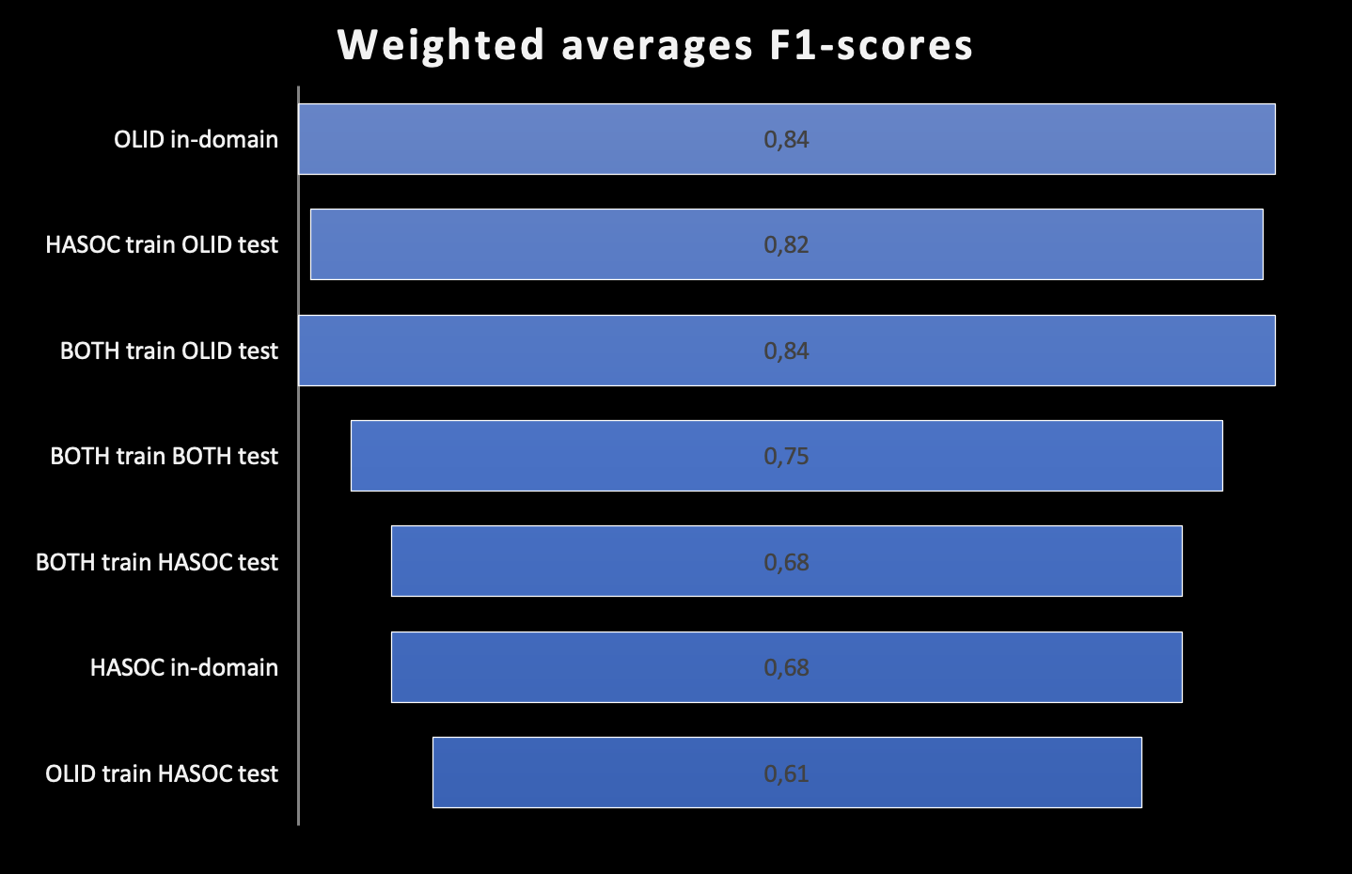
Overview
Key points:
Testing on OLID dataset has high performance throughout
HASOC test set has significantly lower performance throughout
Training on the concatenated datasets and testing on OLID shows very similar scores to OLID in-domain
The same is apparent for testing on the HASOC dataset but with much lower performance
In-domain
Cross-domain
Concatenated OLID & HASOC

Slide 31
What is to come
Perturbations!
Focus on robustness
Challenge datasets
Tracking model learning with the WandB module
Better evaluation of model performance
Both quantitative and qualitative

Slide 32

Take-home message

Slide 33
Thank you for listening
”Divergent views make us more thoughtful, not less; and that we cannot disagree intelligently unless we first understand profoundly.” - Bret Stephens
Questions?

